Slide 1








Understanding Catalunya's Electricity Demand
(Jan 2005–Sept 2024)
Data Analysis Project by Cecil Luna

Slide 2



Is it possible to change your electricity bill? How?

Slide 3
When is the best time or day to do the laundry?

Slide 4
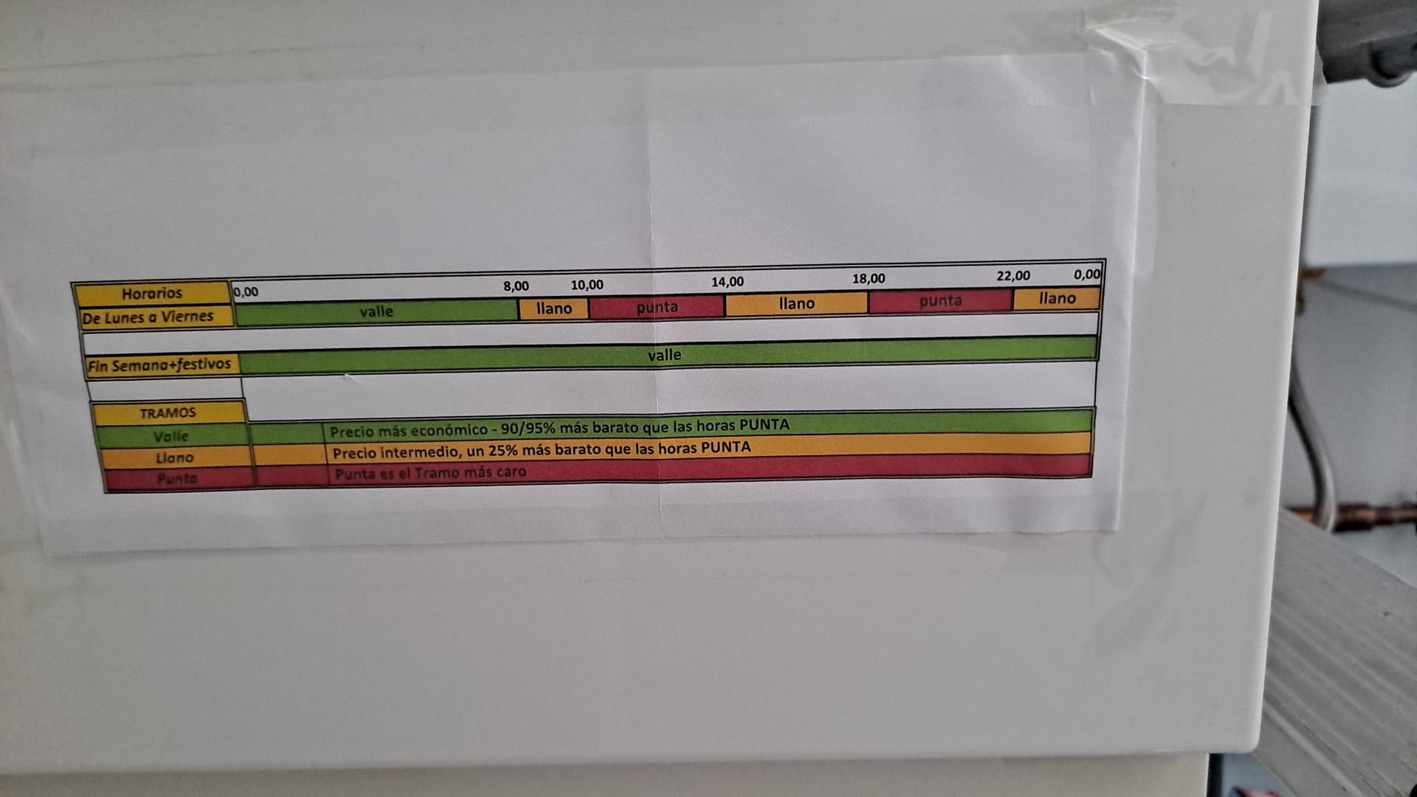

Slide 5
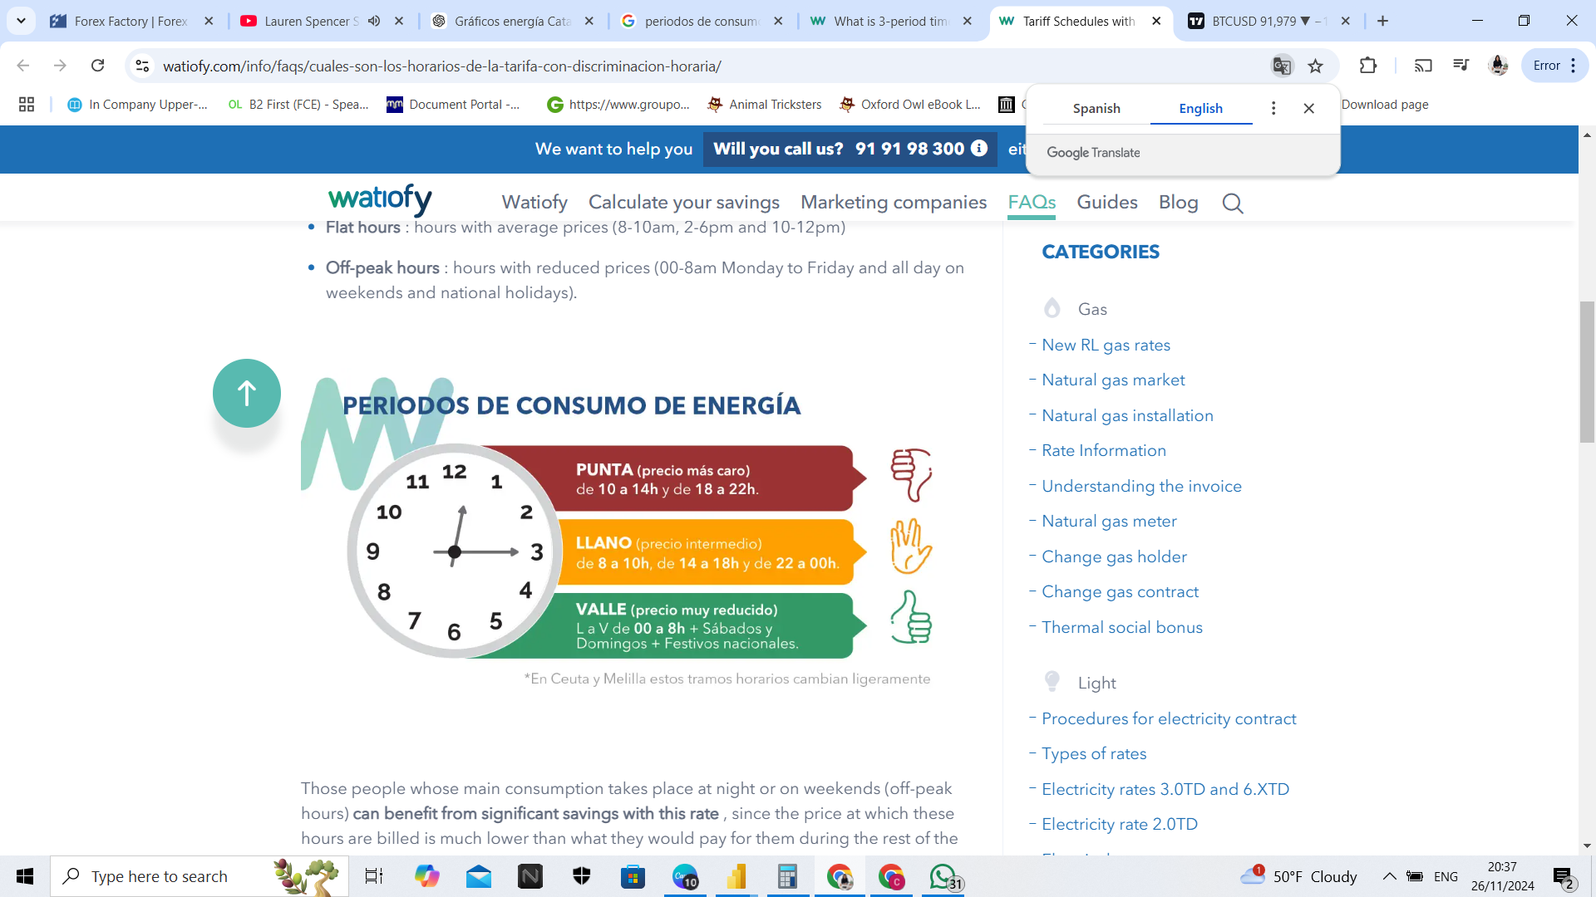
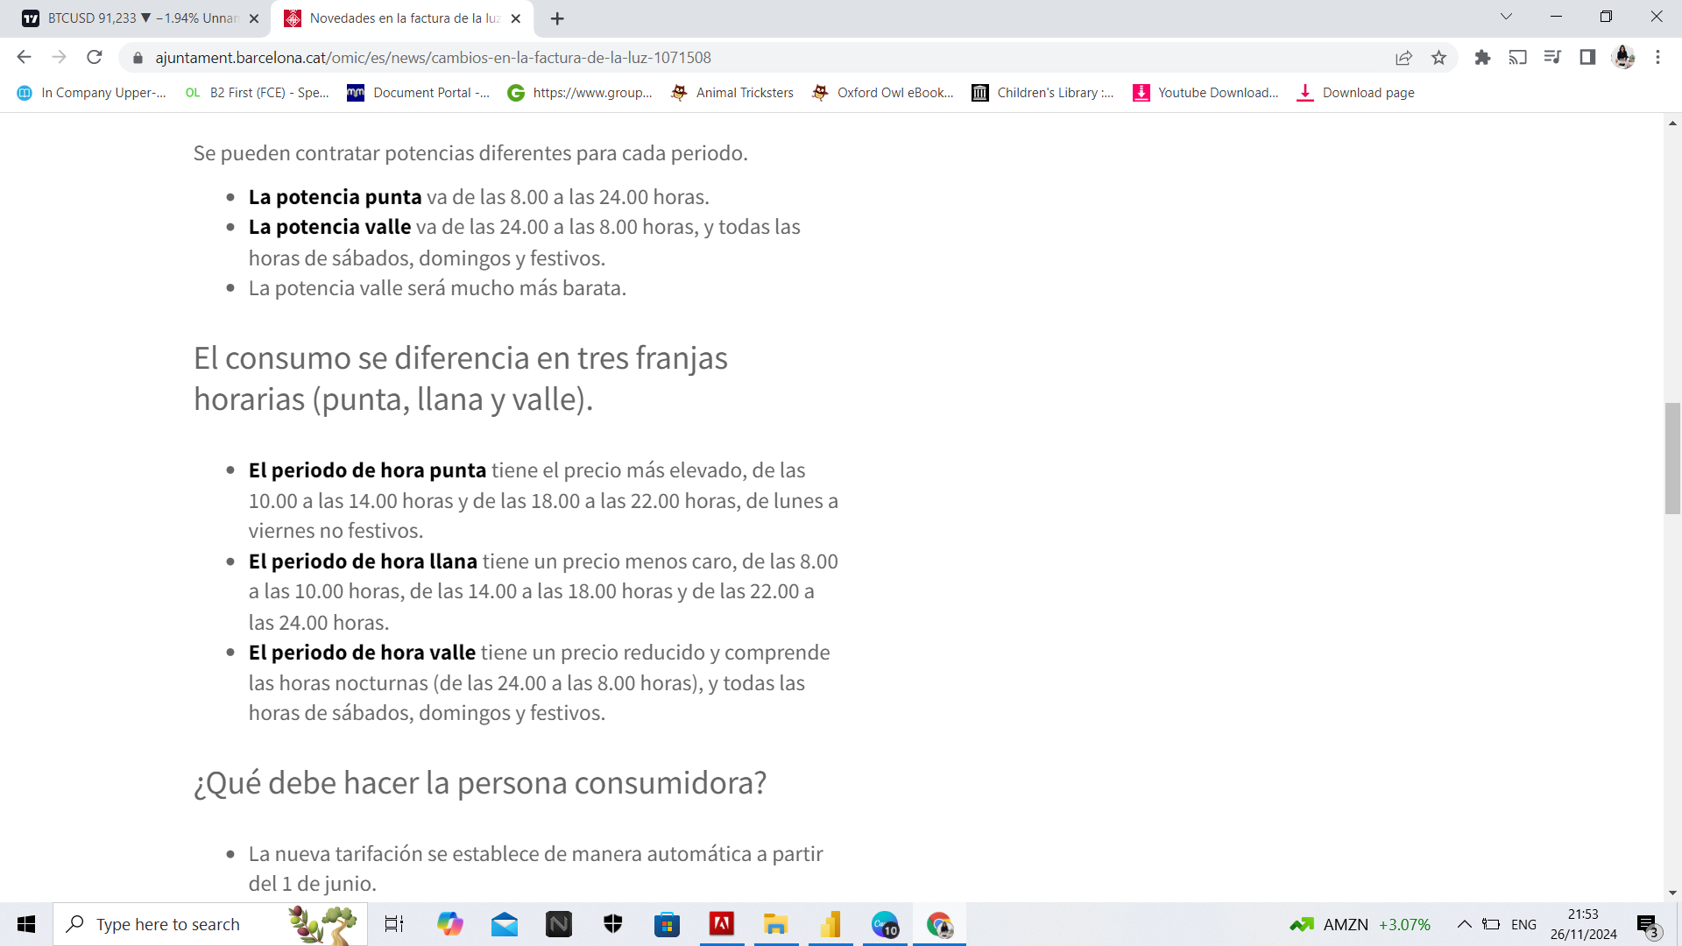
watiofy.com
ajuntament.barcelona.cat

Slide 6

PROJECT
GOALS
Analyze energy consumption patterns in Catalunya from 2005 to 2024.
Identify trends, peak/off-peak hours in Catalunya from 2005 to 2024.
Analyze electricity costs in Catalunya from Sept 2021 to
Sept 2024.

Slide 7

DATA SOURCES

Slide 8





Hourly electricity demand in Catalonia per MWh
Generalitat de Catalunya
Data set on hourly electricity demand at central busbars (EBC), in MWh, from the network of the main electricity distributor in Catalonia. (Until September 2021, the electricity demand also included the electricity transmitted to other distributors).
datos.gob.es
Available formats: CSV, JSON, XML, RDF-XML

Slide 9
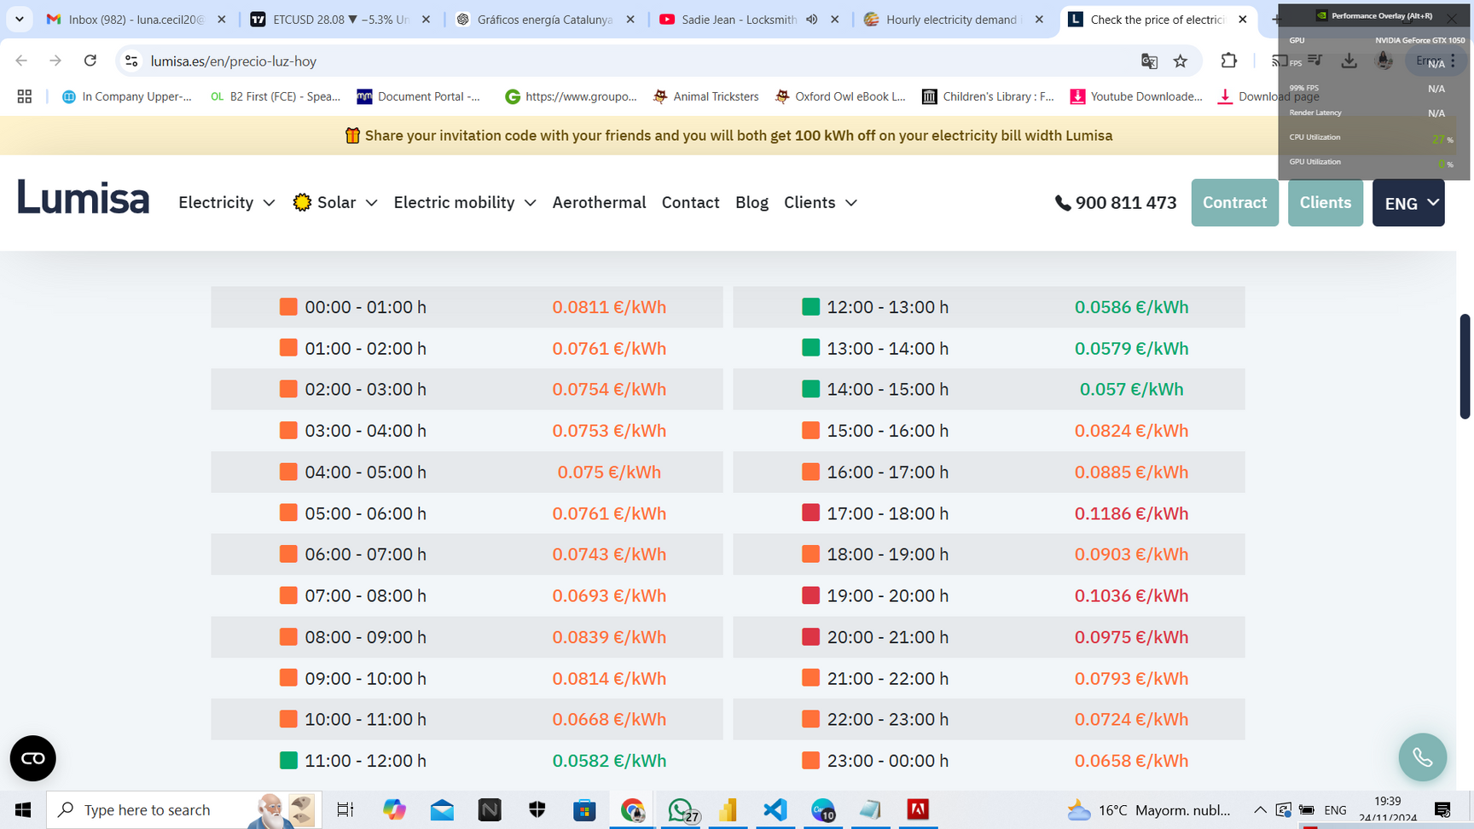
Lumisa Energies
Lumisa Energies is an electricity marketer that operates in the Spanish Electricity Market, founded in 2012, with a unique vision: make use of the technology and the data analysis to offer a fair and affordable energy to homes and businesses.

Slide 10
HOW THE DATA WAS ANALYZED

Slide 11

STEPS TAKEN
Preprocessing:
Added columns to sort days and unpivoted the columns in dataset.
Calculated the price per KWH to MWH.
Created a new table using Lumisa Energies price per KWH.
Visualizing data:
Graphs for trends, peak/off-peak hours, and heatmaps.

Slide 12
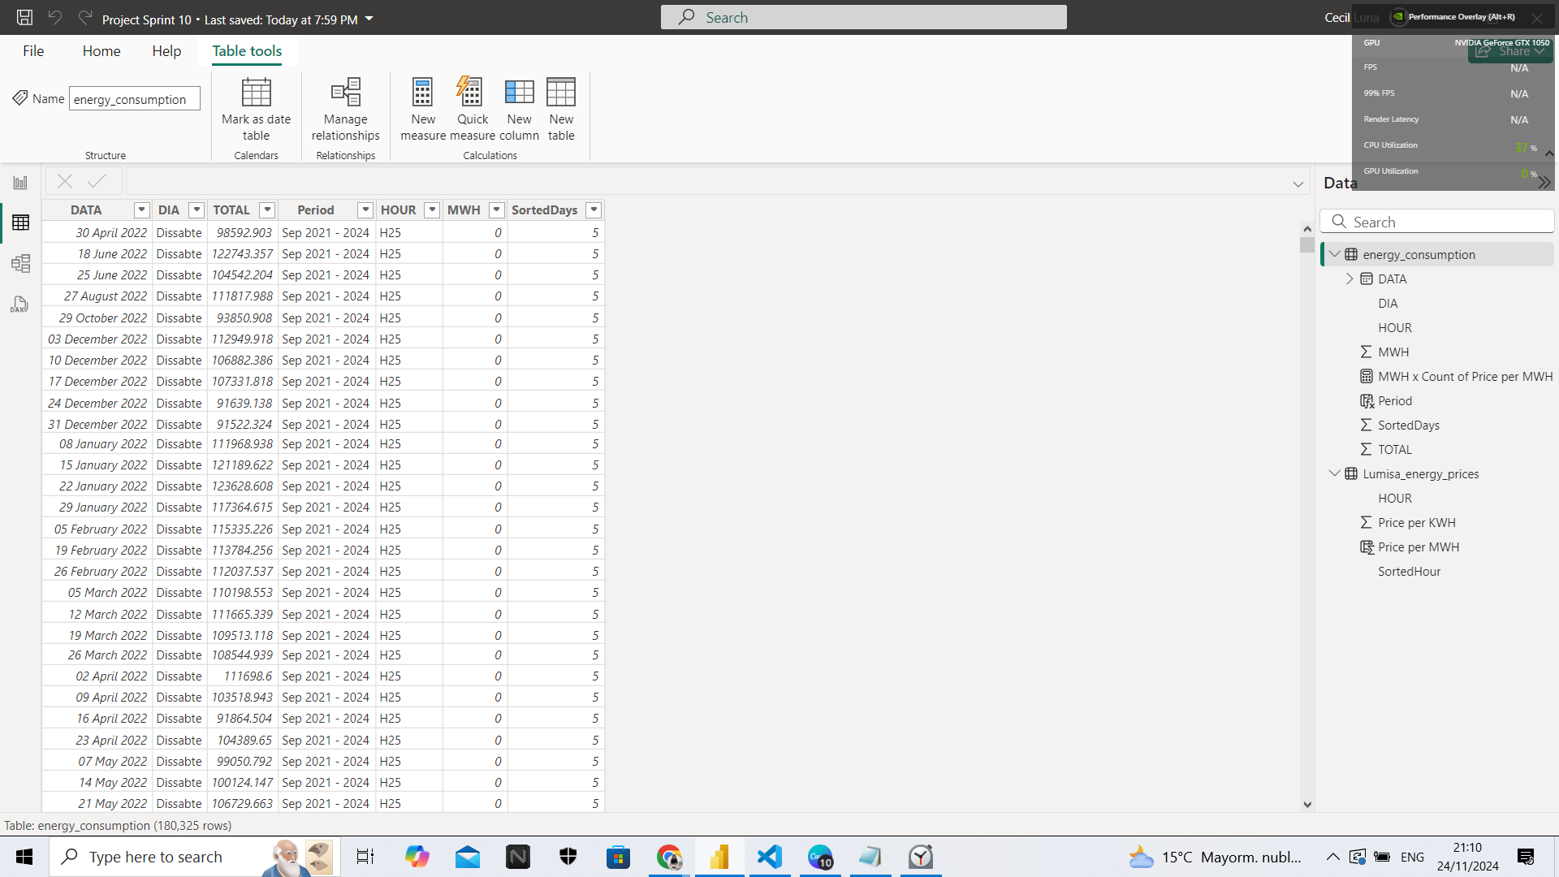
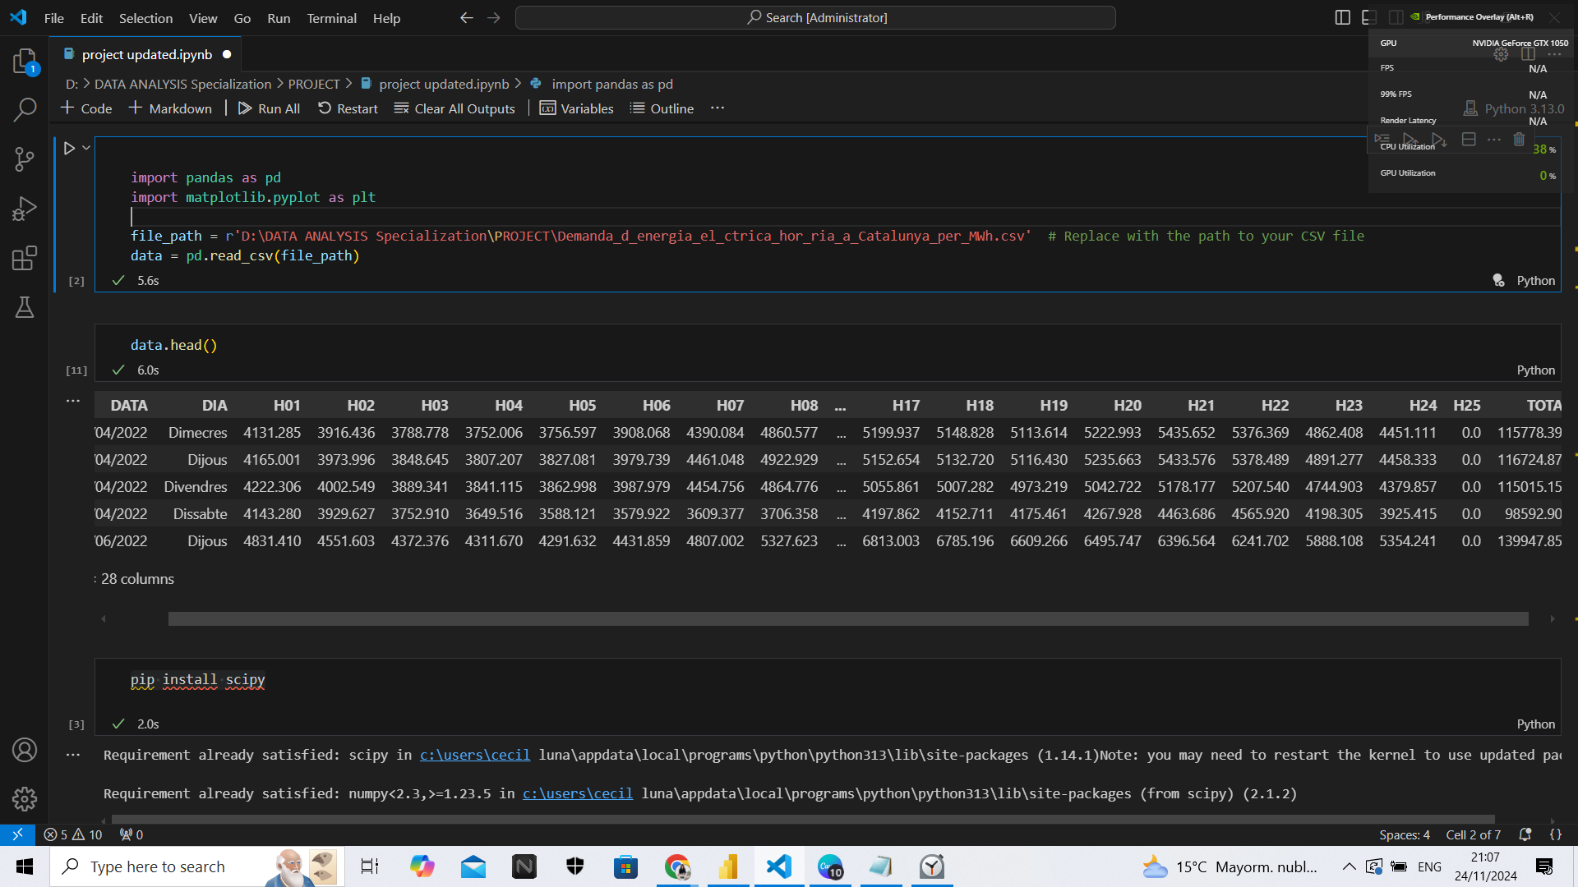
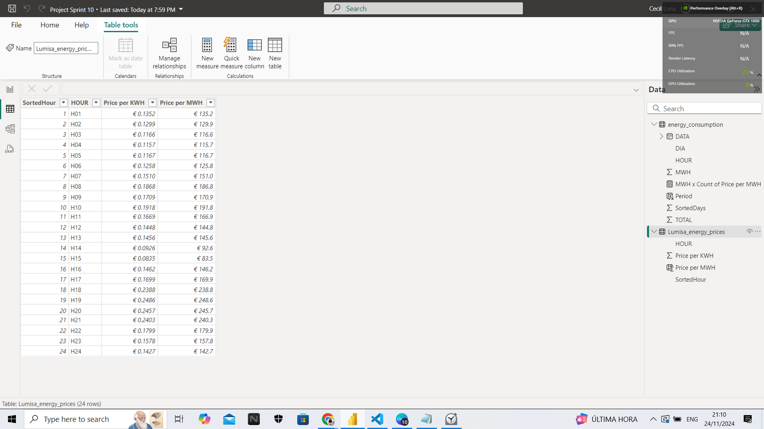
STEPS TAKEN
Before the preprocessing:
After:

Slide 13
CHALLENGES FACED IN THE STUDY

Slide 14

Data Gaps:
Pre- and post-2021 differences in data coverage.
Lack of sector segmentation (residential, commercial, industrial).
No external influences captured:
Weather, economic activities, and events aren’t accounted for.

Slide 15

Key Questions Explored in the Study
Energy Consumption Patterns
(Jan 2005– Aug 2021):
What are the peak and off-peak hours for energy consumption in Catalunya from Jan 2005 to Sept 2021?
How does energy consumption differ across the days of the week during this period?

Slide 16
Key Questions Explored in the Study
Energy Consumption Patterns
(Sept 2021– Sept 2024):
What are the peak and off-peak hours for energy consumption in Catalunya from Sept 2021 to Sept 2024?
How does energy consumption vary by day of the week during this period?

Slide 17
Key Questions Explored in the Study
Energy Costs Based on Lumisa's Price Rates:
During which hour(s) did residents in Catalunya pay the highest and lowest energy prices?
On which day(s) did residents in Catalunya pay the highest and lowest energy prices?

Slide 18
DATA INSIGHTS

Slide 19
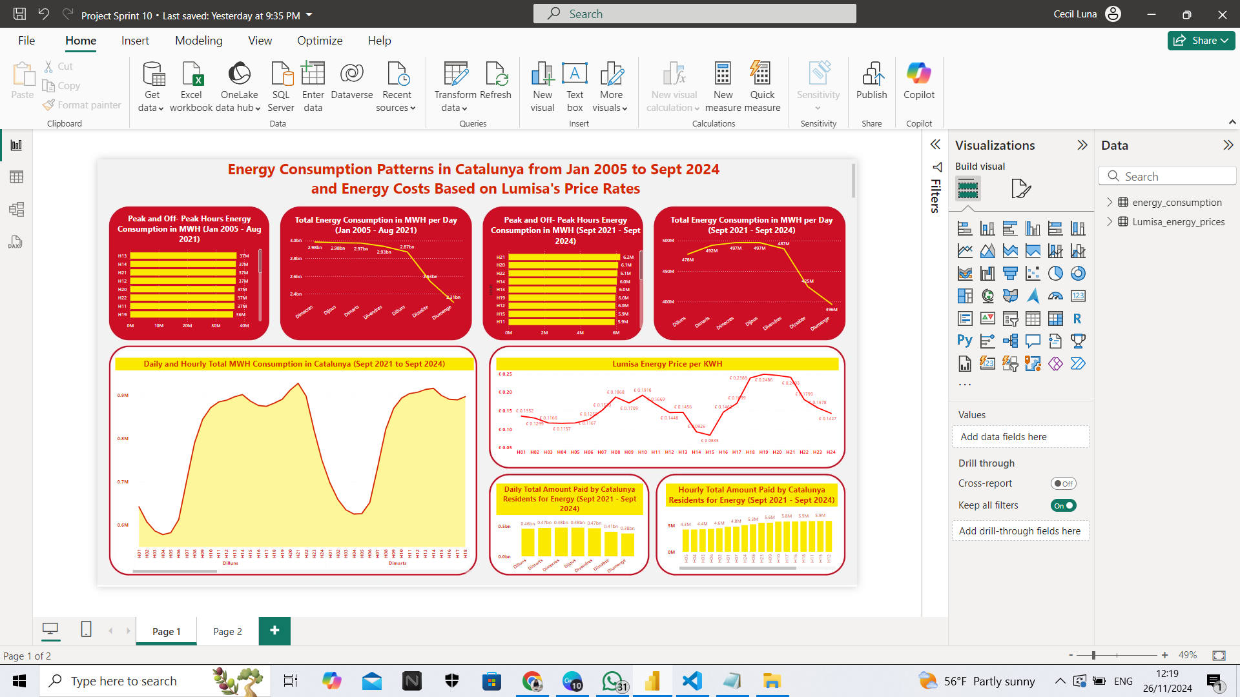

Slide 20
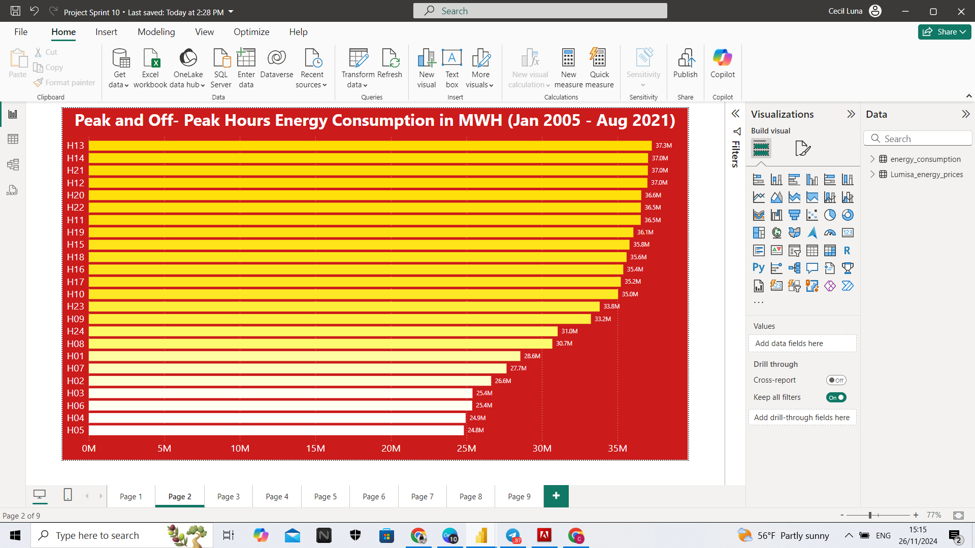
What are the peak and off-peak hours for energy consumption in Catalunya from Jan 2005 to Sept 2021?
HOURS
MWH

Slide 21
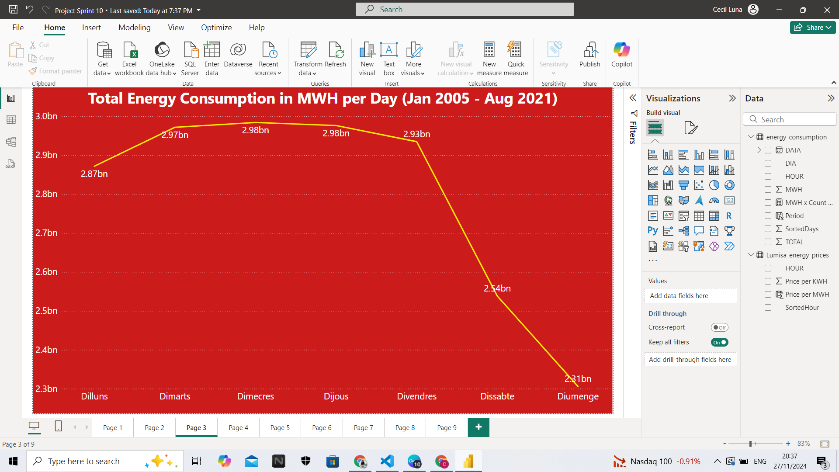
How does energy consumption differ across the days of the week during this period?
MWH
DAYS

Slide 22
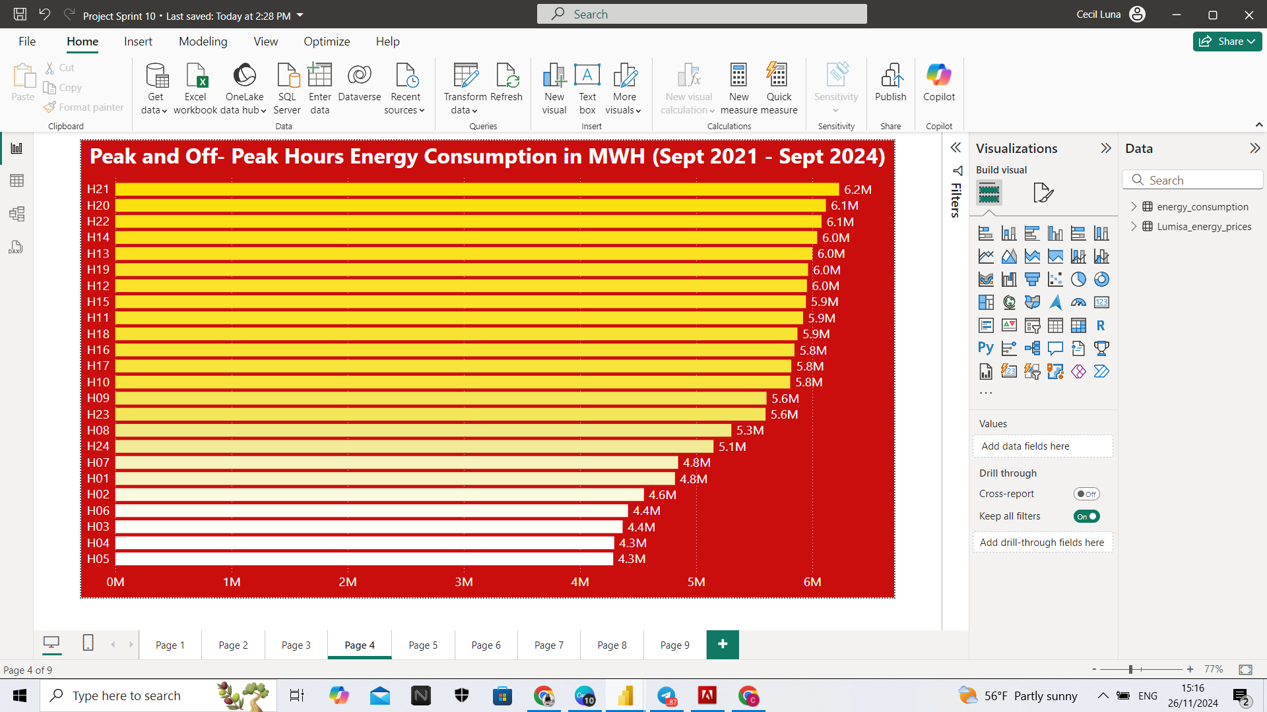
What are the peak and off-peak hours for energy consumption in Catalunya from Sept 2021 to Sept 2024?
HOURS
MWH

Slide 23
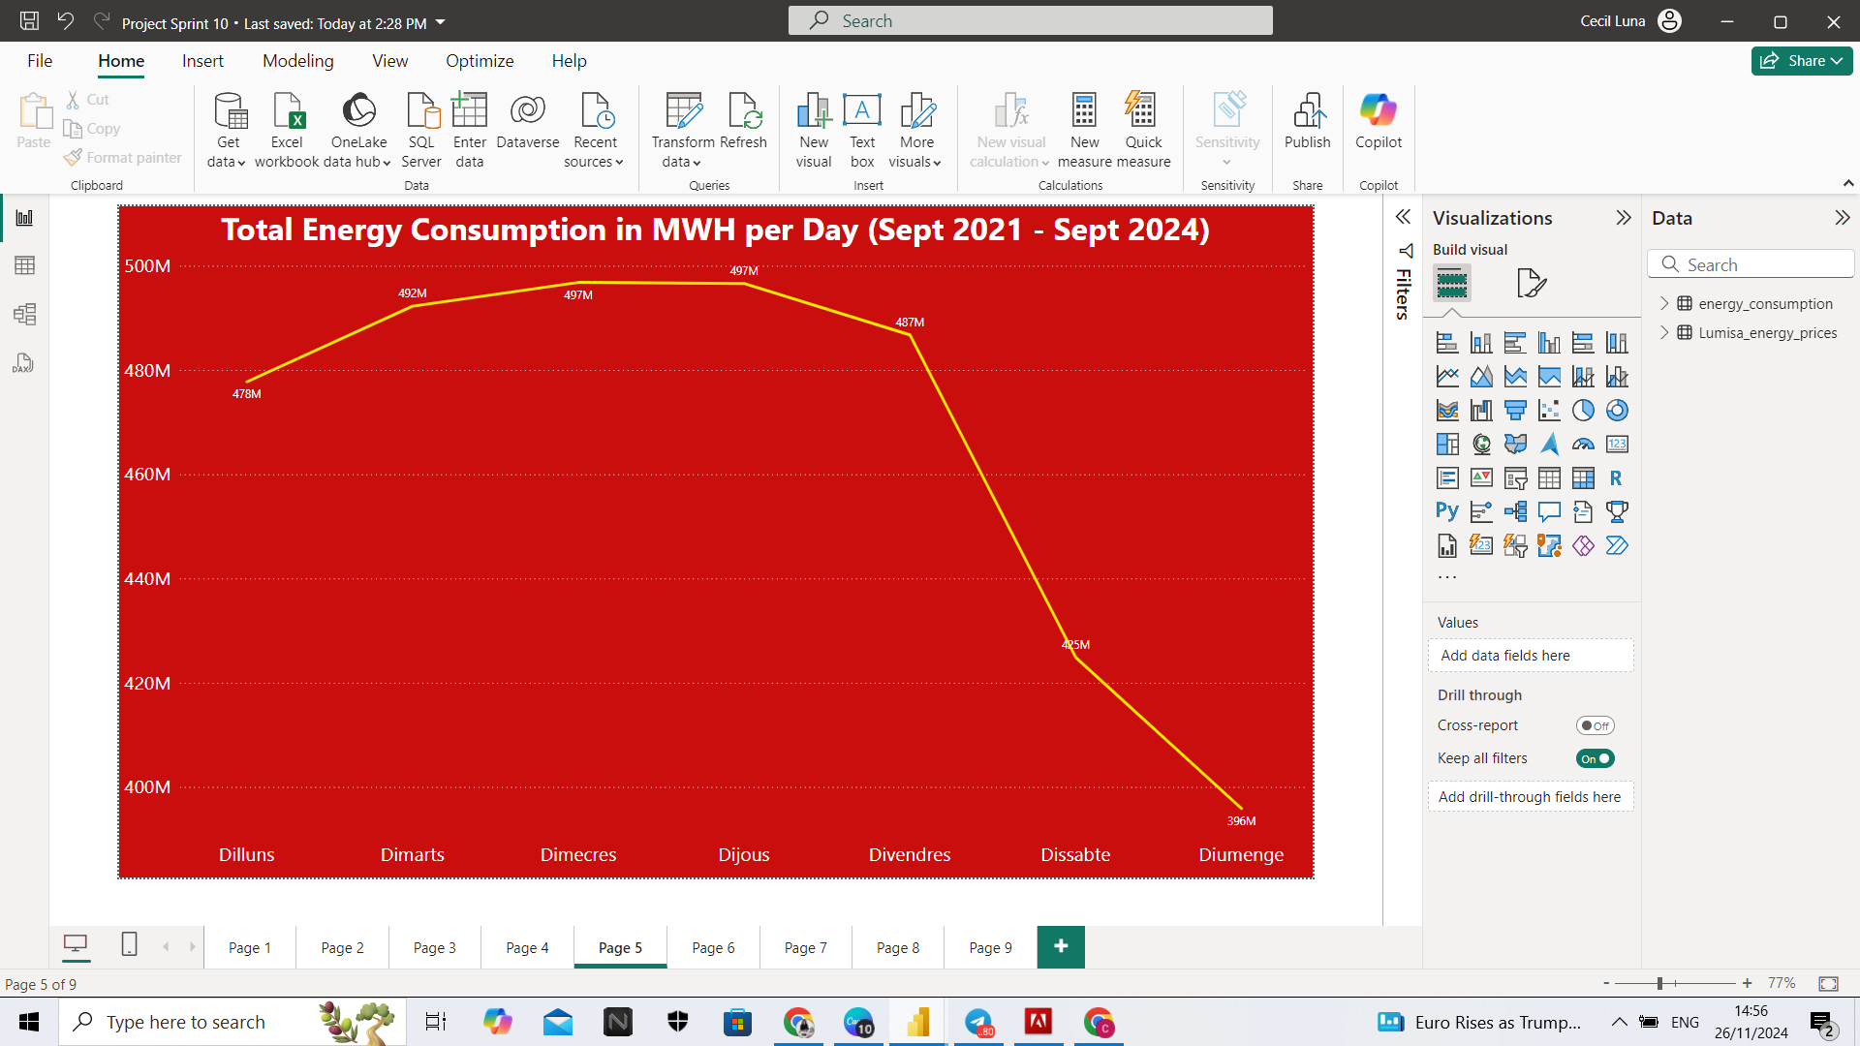
How does energy consumption vary by day of the week during this period?
MWH
DAYS

Slide 24
COMPARISONS FOR JAN 2005–AUG 2021 AND SEPT 2021– SEPT 2024

Slide 25
COMPARISONS FOR JAN 2005–AUG 2021 AND SEPT 2021– SEPT 2024

Slide 26
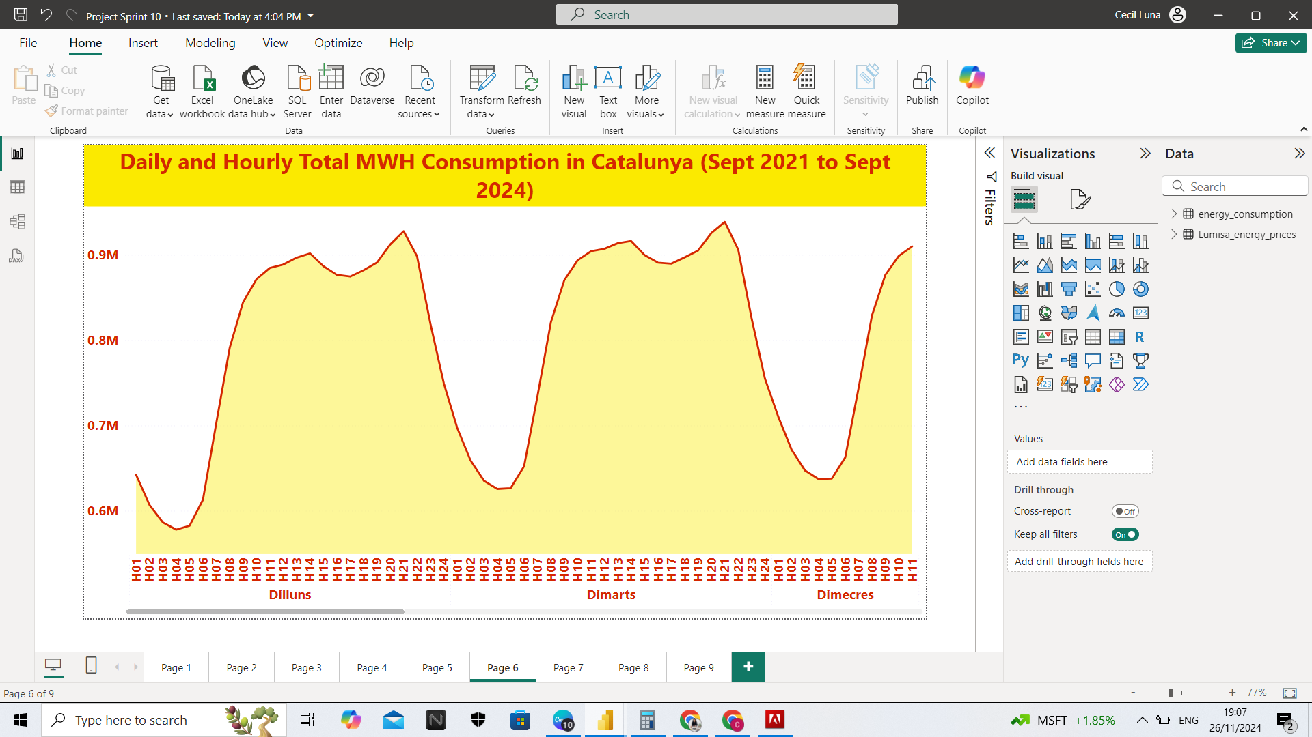

Slide 27
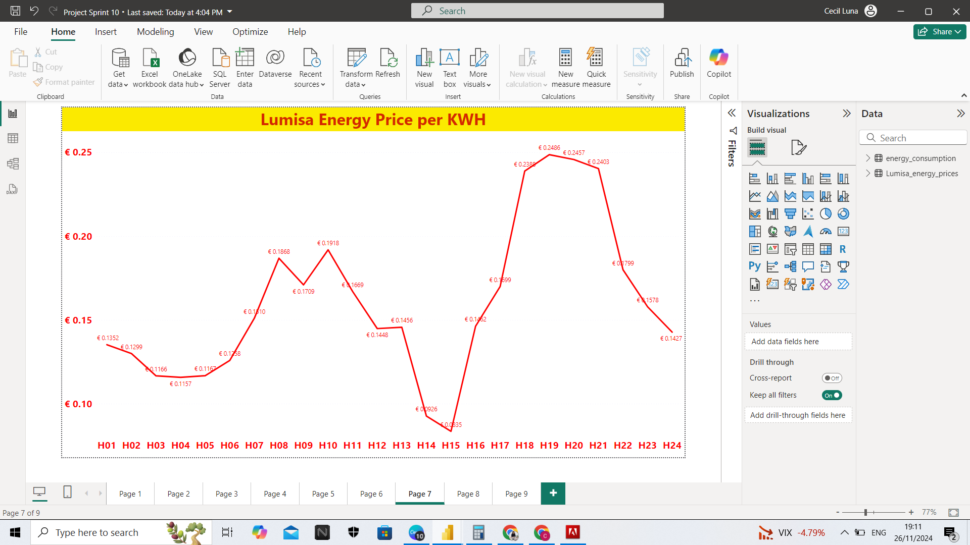
PRICE IN EUROS
HOURS

Slide 28
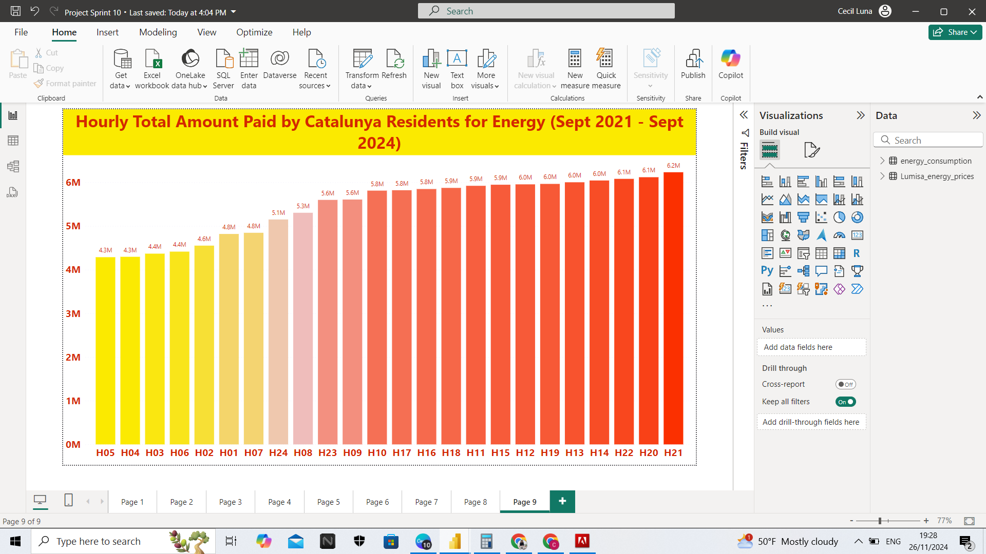
During which hour(s) did residents in Catalunya pay the lowest and highest energy prices?
PRICE IN EUROS
HOURS

Slide 29
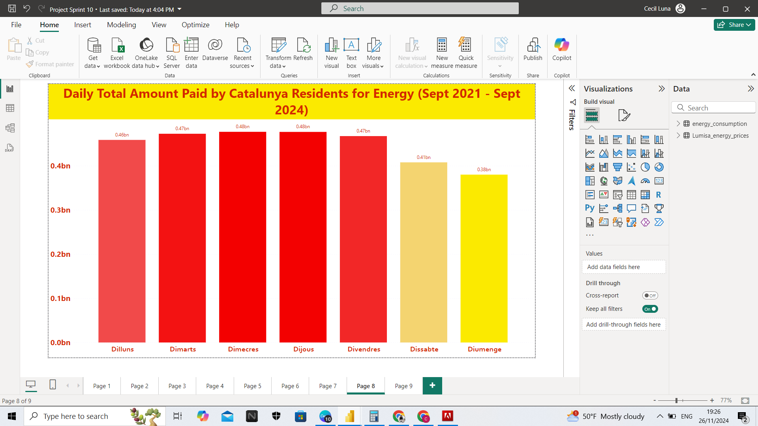
On which day(s) did residents in Catalunya pay the highest and lowest energy prices?
PRICE IN EUROS
DAYS

Slide 30
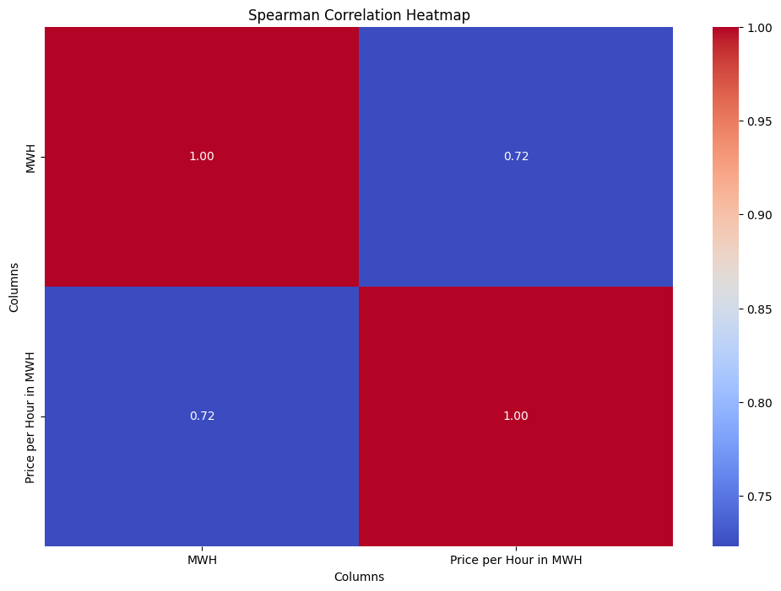
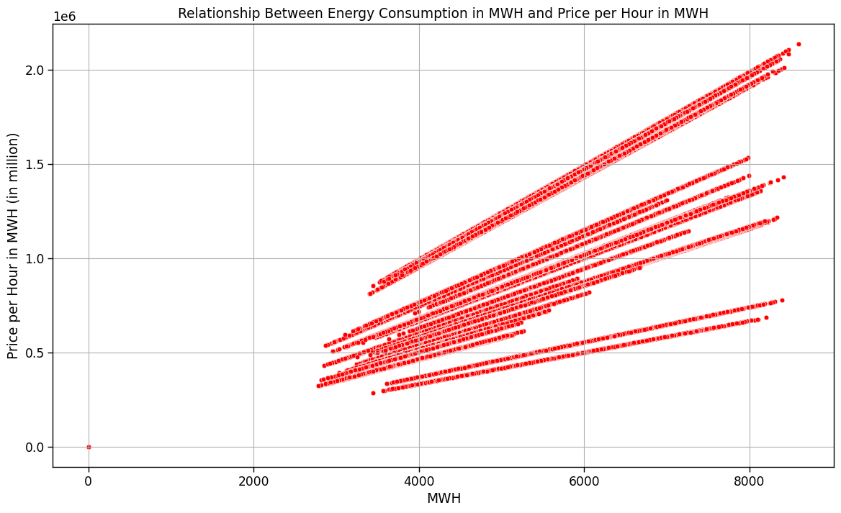
CORRELATION USING HEATMAP
AND SCATTER PLOT

Slide 31
CONCLUDING INSIGHTS AND TAKEAWAYS

Slide 32
May impact future electricity bills.
Weekends may retain lower rates and consumption.
5h–7h might stay optimal for weekday laundry.
Avoiding 14h and 21h could reduce costs.
Insights could guide off-peak energy use.

Slide 33


Future Studies
Explore the reasons behind the change in energy consumption.

Slide 34
Is it possible to change your electricity bill? How?

Slide 35
When is the best time or day to do the laundry?

Slide 36

Thoughts?
123 Anywhere St., Any City

Slide 37

Thank you!

